Slide 1
Age, Gender and Emotion detection
using Machine Learning
By Mahavir Chandaliya
(016003325)
Computer Engineering
San Jose State University

Slide 2
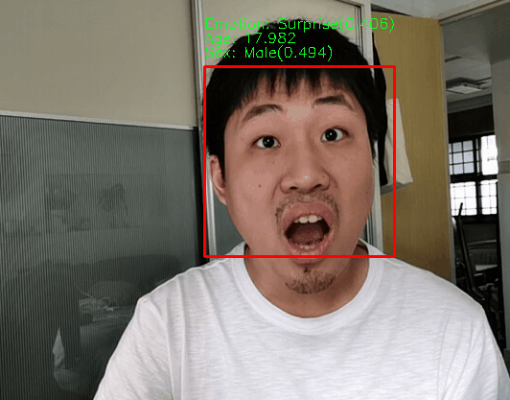
Introduction
An application of neural networks and computer vision to predict age, gender and emotion of the person captured in the video from digital devices.
Face image datasets and facial expressions datasets for training the models developed in this research.
Model uses CNN model for predictions.

Slide 3



Motivation
The world went through the pandemic of coronavirus also known as Covid-19; a communicable disease that spreads very fast from close contact with the person tested positive for Covid-19.
Virtual meetings on different online platforms such as Google meetings, zoom and Microsoft teams are being used by a large number of people and institutions.
Live streams and use of webcams have become largely used medium for organizing virtual events and interactions. This massive increase in use of webcams and video cameras have solved a lot of problems that we have faced due to this dangerous contagious disease
Also Gave us a rich source of facial data that can be further explored.

Slide 4
Businesses can use this data to develop better customer relationships, increase sale of their products by targeting relevant markets and simply understand their customers better.
Real time age, gender and emotion predictions can also be utilized in the field of security and protection.
Educational institutions can conduct surveys and obtain feedback from these predictions obtained from students during online lectures, which can be helpful to further develop the structure of the classes and educational materials that can enhance the educational experience of the students and further improve the standards of the institution.

Slide 5
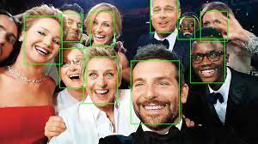
Solution
The application uses the programming language python and different sets of libraries to implement the given functionalities. “Opencv” is a python library
We have used MTCNN python module for face detection from the captured video.
MTCNN stands for ‘Multi-task Cascaded Convolutional Networks’, which is a framework built using python libraries of OpenCV and PyTorch.
The core of the application uses three models to detect age, gender and emotion of a person developed using neural networks, these models are trained on datasets to predict the output from the facial data

Slide 6
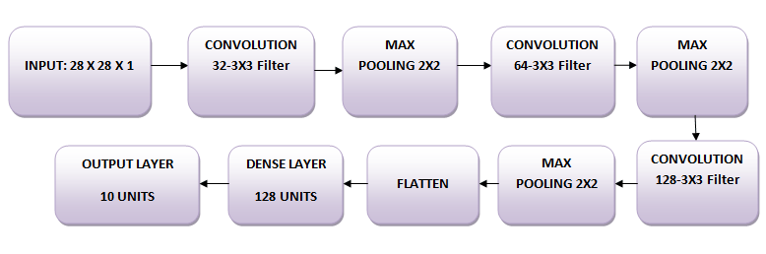
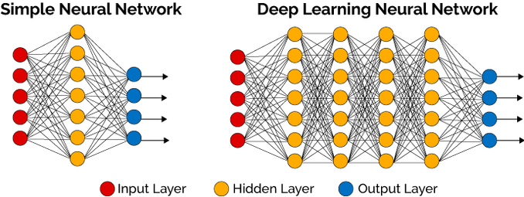
Model Structure

Slide 7
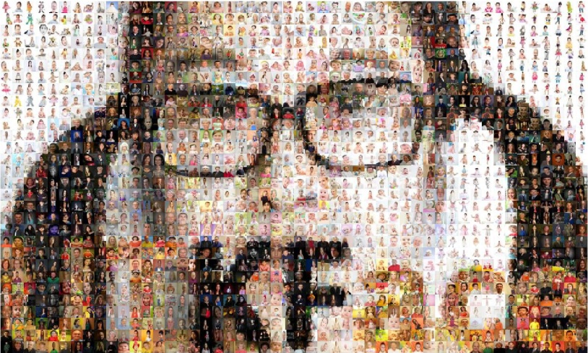
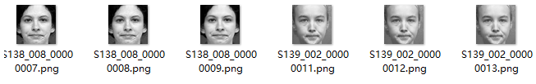
Learning and Datasets
The emotion model developed in the research is trained on the CKPlus Facial Emotion dataset obtained from the website ‘kaggle’.
The CKPlus facial Emotion dataset contains 981 images with labeled emotions. The emotion labels comprise of ‘anger, contempt, disgust, fear, happy, sadness and surprise’.
The Age and Gender models are trained on the UTKface datasets which contains 20k images which are labeled with person’s age, gender and race. The UTKface dataset is available for public on github.
CK+ dataset for facial expression recognition.

Slide 8


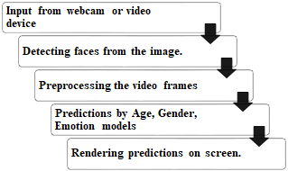
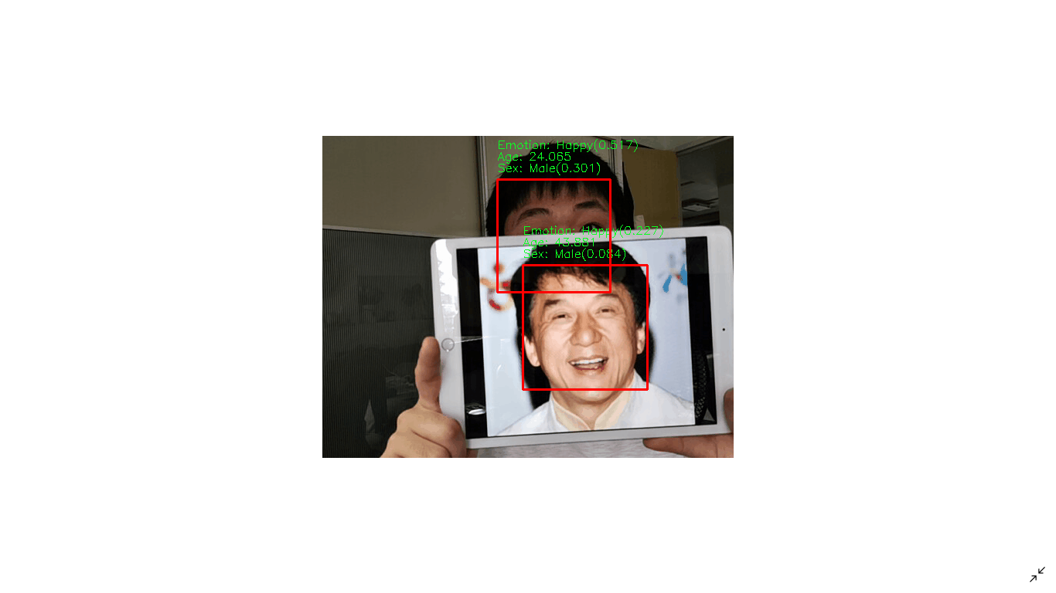
Implementation

Slide 9
Further Development
Occlusion is a challenge when developing object detection applications in Computer Vision.
Occlusion occurs when we want to see something, but are unable to due to some event or the way our sensor is setup. A model which is more resistant to occlusions can be used.
Another challenge faced in developing computer vision systems is Automatic calibration. The process of determining internal camera parameters directly from a number of un-calibrated images of unstructured scenes is Auto Calibration.
Implementing Automation can result in further improvement of this methodology making it more effective.

Slide 10

The devised methodology in this paper can be further improved to provide a real time analysis of facial data by using a faster model which further provides insights into various other aspects of the person.
Along with displaying the age, gender and emotion of the person the application can keep the track of the emotional state of a person recorded from the video device and give an output of a more detailed analysis.
Furthermore, by using a NVIDIA GPU or a High power GPU, this system can run more effectively in real-time.

Slide 11
References

Slide 12
Thank You

